Slide 1
Math 642 Introduction to Machine Learning Lecture 2: Unsupervised Learning: Principal Components Analysis, Clustering
Spring 2020
Some of the figures in this presentation are taken from "An Introduction to Statistical Learning, with applications in R" (Springer, 2013) with permission from the authors: G. James, D. Witten, T. Hastie and R. Tibshirani

Slide 2
2020 Class Schedule
Lec | Date | Lecture | Due
1 | Jan 15 | Intro, Linear Regression, Bias and Variability
2 | Jan 22 | Unsupervised Learning: Clustering, Principle Comp. Analysis | Hwk 1
3 | Jan 29 | K Nearest Neighbors, Cross Validation | Hwk 2
4 | Feb 5 | Classification, Logistic Regression | Hwk 3
5 | Feb 12 | Feature Selection, Ridge Regression, LASSO, Principle Comp. | Hwk 4, Project Plan
6 | Feb 19 | Step Functions, Splines | Hwk 5
7 | Feb 26 | Discriminant Analysis, Support Vector Machines | Hwk 6, Plan Revision
 | Mar 4 | Mid Term Exam
 | Mar 11 | Spring Break
8 | Mar 18 | Tree-Based Classification Methods | Hwk 7
9 | Mar 25 | Neural Networks, Deep Learning | Hwk 8
10 | Apr 1 | Convolutional Neural Networks | Hwk 9
11 | Apr 8 | Bayesian Analysis | Final Project Due
12 | Apr 15 | Project Presentations | Hwk 10
13 | Apr 22 | Ethics of Machine Learning, Project Presentations
 | Apr 29 | Study Day
 | May 6 | Final Exam

Slide 3
Machine Learning Taxonomy
Statistical Learning
Outcomes
No Outcomes
Supervised
Unsupervised
Quantitative
Estimation
Outcome
is a Number
Outcome
is a Class
Classification
Clustering
Principal
Components
Logistic Regression
Parametric
Estimation
Non-Parametric
Estimation
Bayesian Belief Network
LDA/QDA
y = f(x)
non-equation
based
KNN
Linear Regression
SVM
KNN
Common Elements
Cross Validation
Feature Selection
Gradient Descent
Boosting
Ridge Regression
Clustering
Trees
LASSO
Decision Trees
Bayesian Analysis
Splines
Time Series
Neural Nets

Slide 4
ISLR Roadmap
Principle Components – Chapter 10.2
K Means Clustering – Chapter 10.3.1
Hierarchical Clustering – Chapter 10.3.2
This is out-of-sequence with the text BUT I want you to use these techniques when examining your candidate datasets for your projects

Slide 5
Text and Data
Text: An Introduction to Statistical Learning with Applications in R, Springer, 2013, by Gareth James, Daniela Witten, Trevor Hastie and Robert Tibshirani.
Go to the website
http://www-bcf.usc.edu/~gareth/ISL/
You will need to download the text and all datasets
The first half of this course will follow the book, although not in the same order. Homeworks in the first half of the course are taken from the book exercises, so you will need the data sets. The second half of the course will be special topics and project work.

Slide 6
Communications / Homework
I’ll post the powerpoint to Canvas prior to the lecture
Watch on Canvas for announcements
Submit homework over canvas. Markdown is a good format https://rmarkdown.rstudio.com/lesson-1.html
When it snows, you will get an invitation to ZOOM, and we will do the lecture virtually. We should practice once before the real thing.

Slide 7
Review from Last Week

Slide 8
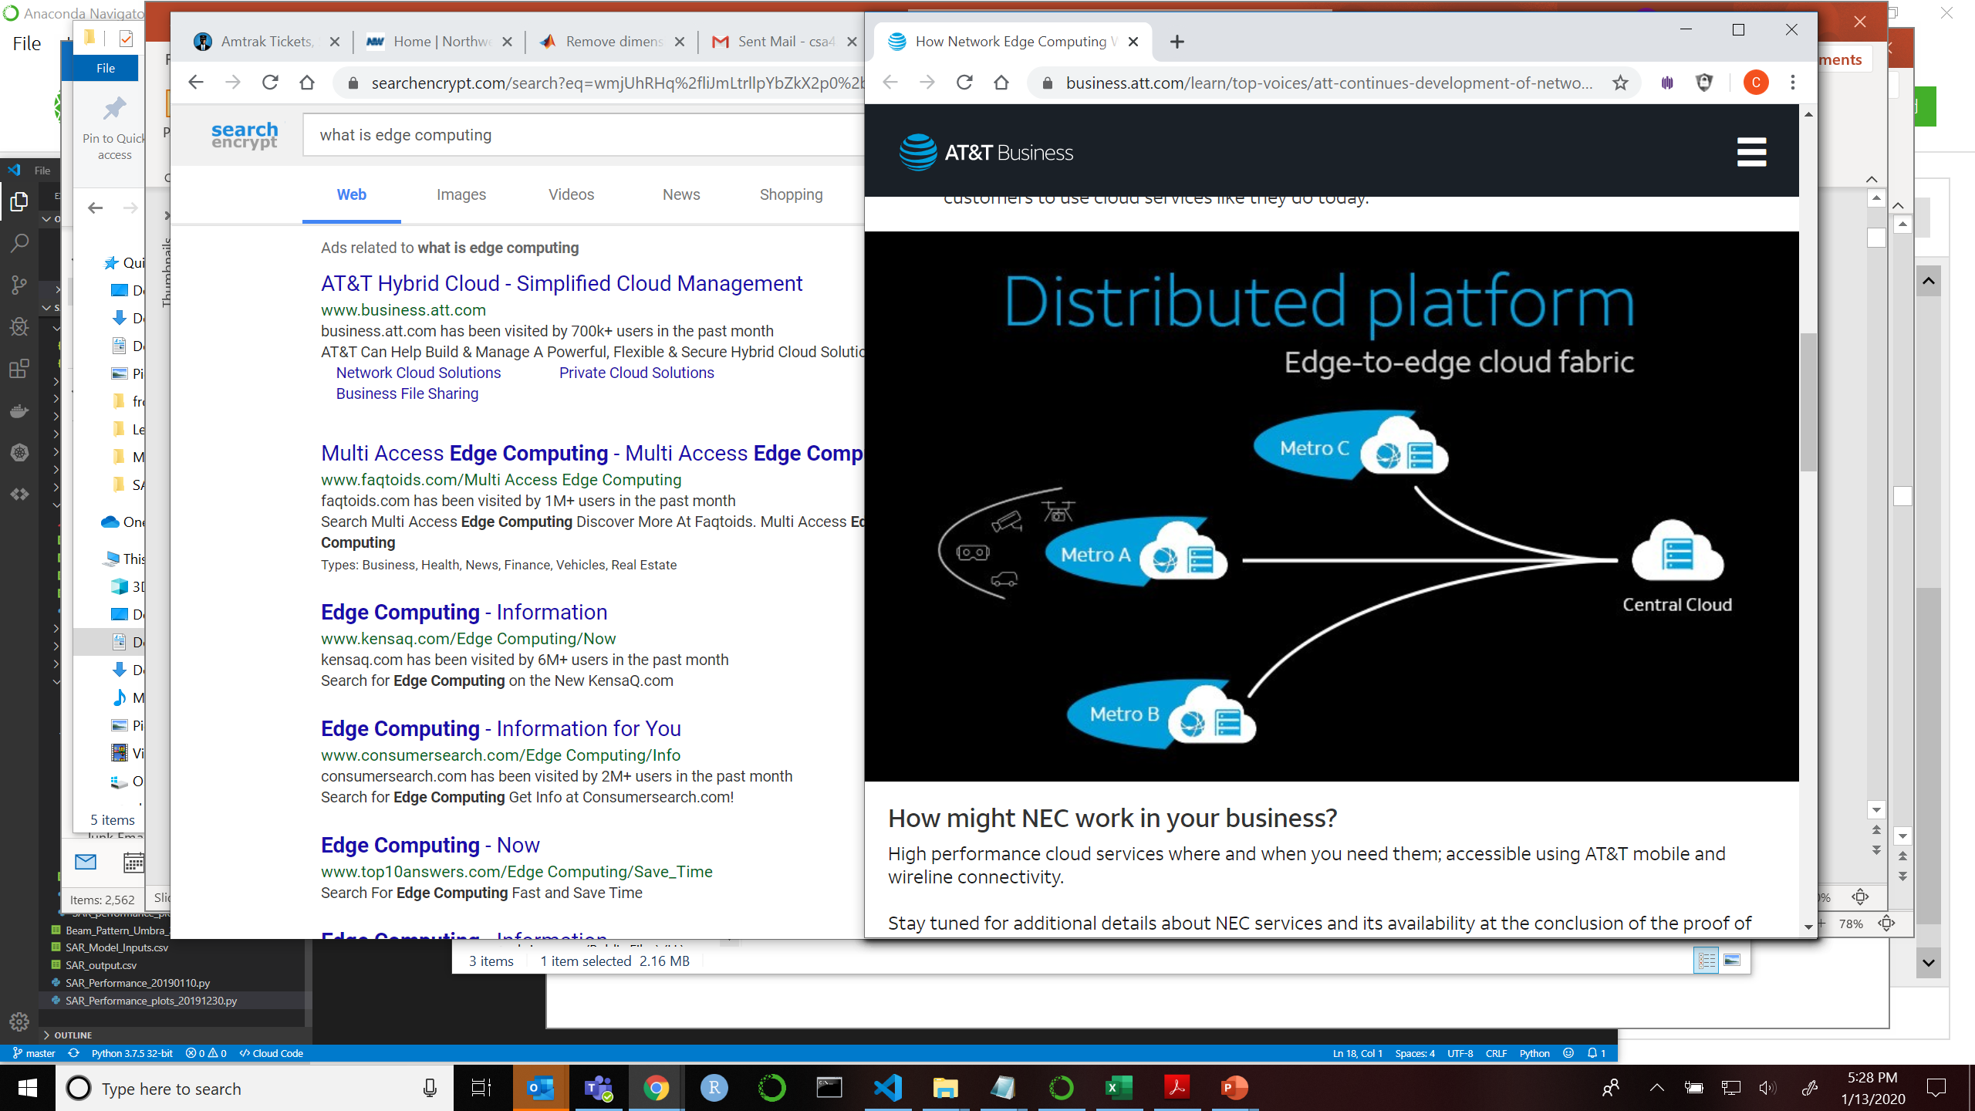



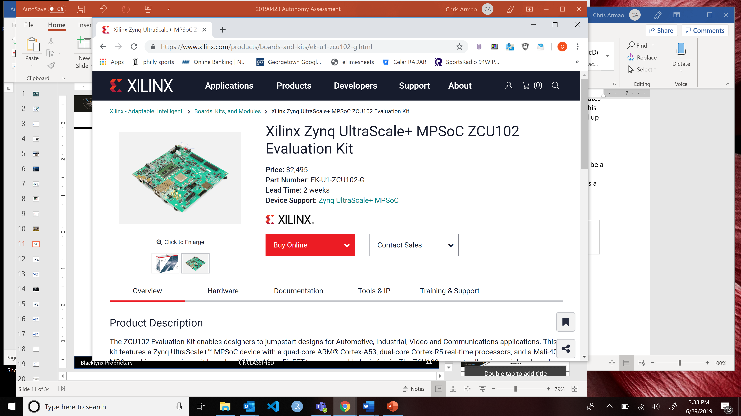

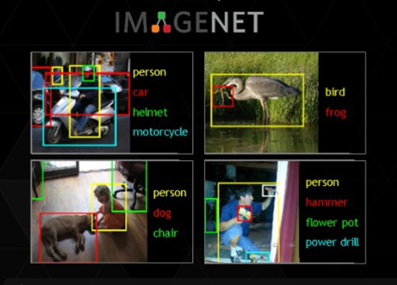
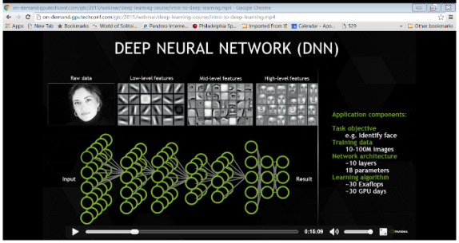
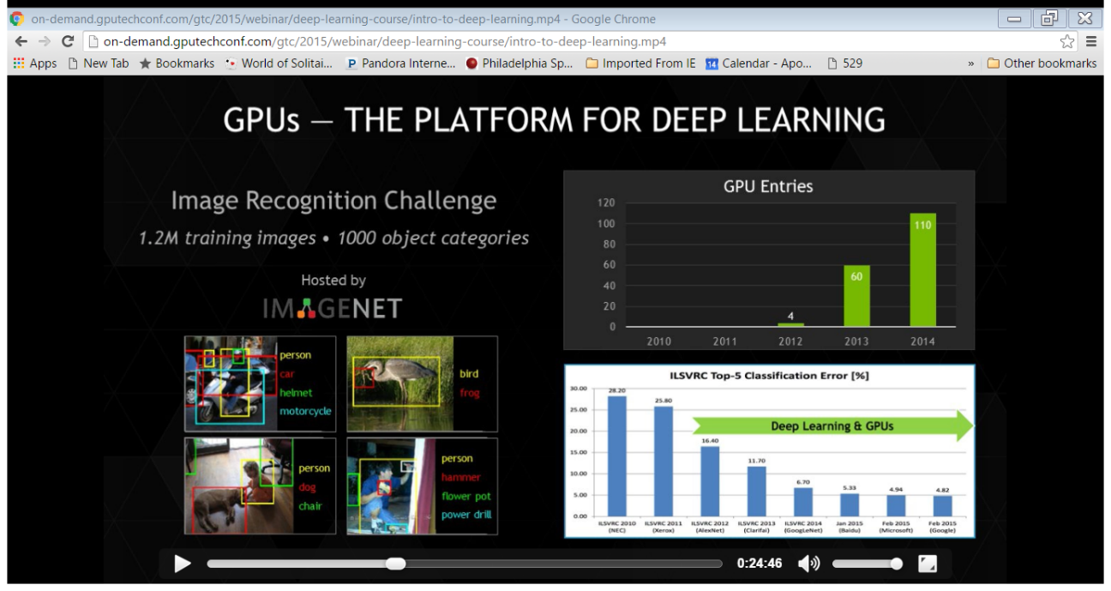
The Machine Learning Revolution
Better Sensors
Faster Computers
Better Algorithms

Slide 9
Making Better Models
In a general sense this class is about making better models… but what makes a model better?
It depends on the use of the model
More accurate – useful for medical diagnosis
Faster – useful for recommending a stock trade
Requiring less data – useful for rare events, like predicting nuclear war
Requiring no outcomes – useful for social network analysis
Easy to visualize – useful for explaining budget recommendations
Low false alarm rate – useful for emergency warning systems

Slide 10
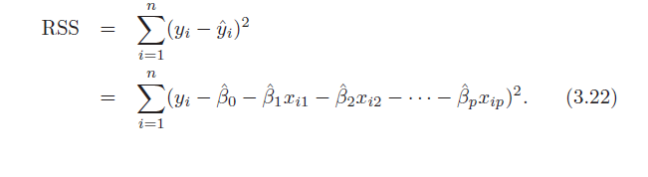
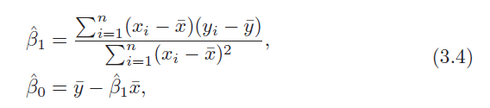
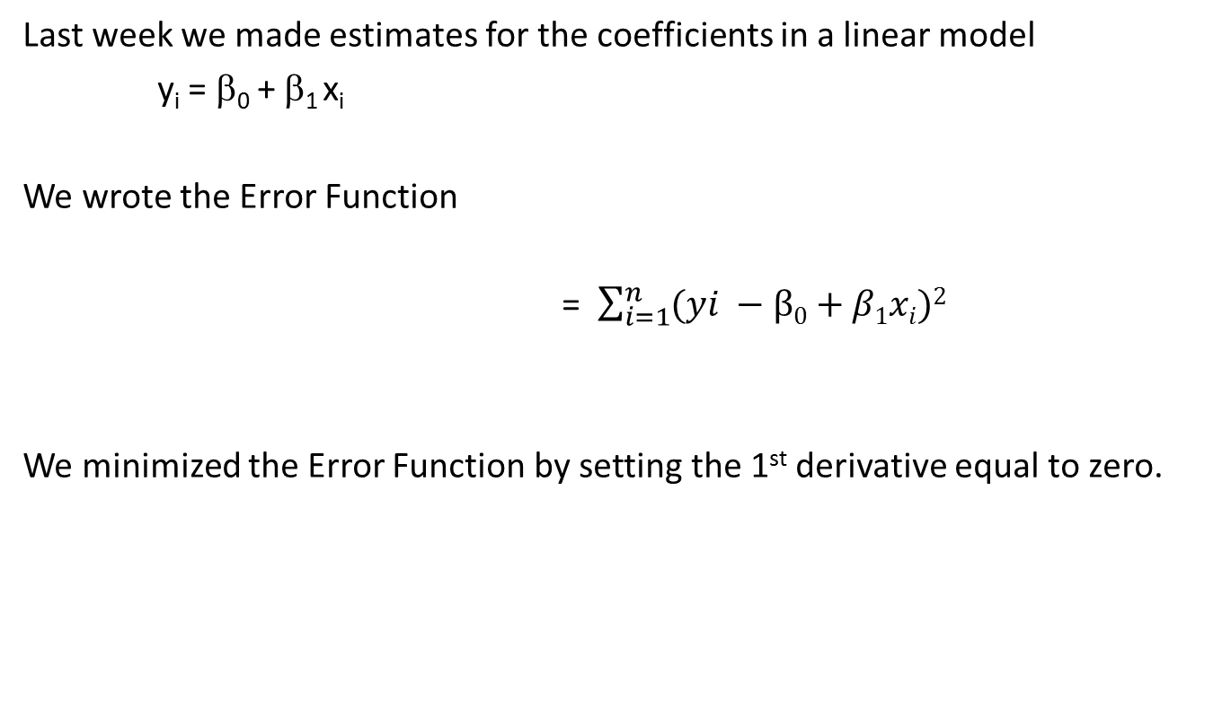
Last Week we Looked at Linear Regression
Last week we made estimates for the coefficients in a linear model
y_{i} = β₀ + β₁ x_{i}
We wrote the Error Function
= $\sum_{i=1}^{n}{(yi −β0+β1xi)2}$
We minimized the Error Function by setting the 1st derivative equal to zero.
^
^
^
^
^

Slide 11
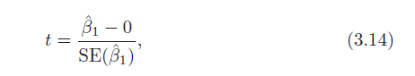
Does the Feature Model the Outcome?
H₀: The feature is NOT correlated to the outcome (3.12)
β₁ = 0
H1: The Feature IS correlated to the outcome (3.13)
β₁ ≠ 0
Then calculate the t-score
If β₁ is 0, then we’re saying that as y varies, our model using β₁ is flat. Thus our model is unlikely to be good. Conversely, if β₁ is not zero, then we’re saying that as y varies, our model using β₁ also varies, so the model is good.
The probability that my t value is as measured (give the null hypothesis, that the model is true) is the probability value, or p-value. If p is small, reject H₀, the feature is correlated to the outcome. If p is large, accept H₀, the feature is NOT correlated to the outcome.
^
^

Slide 12
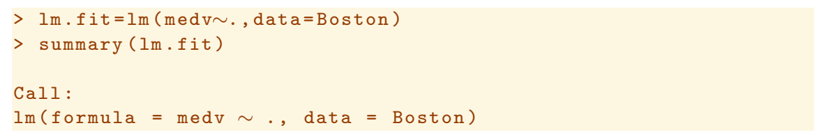
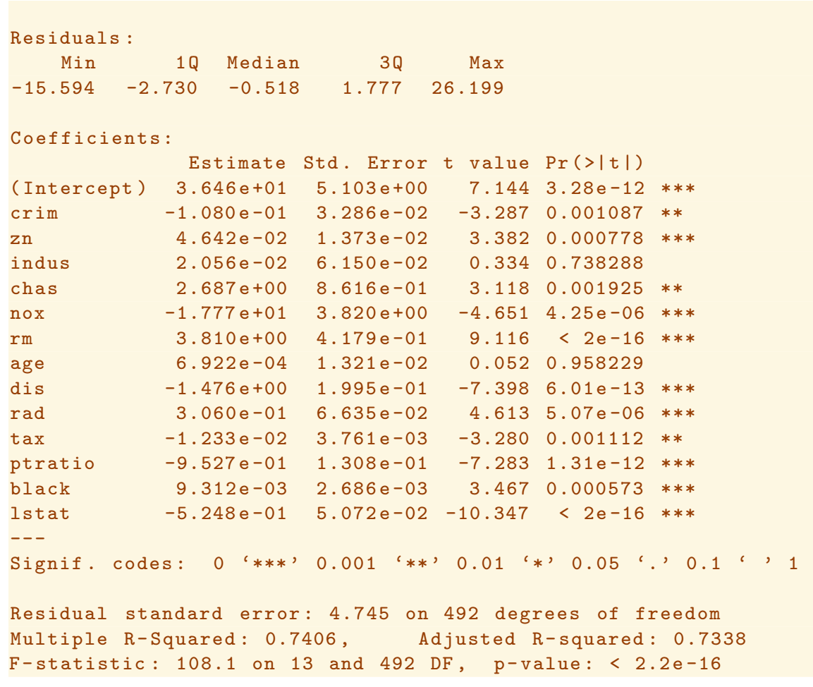
Basic Model

Slide 13
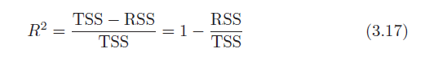
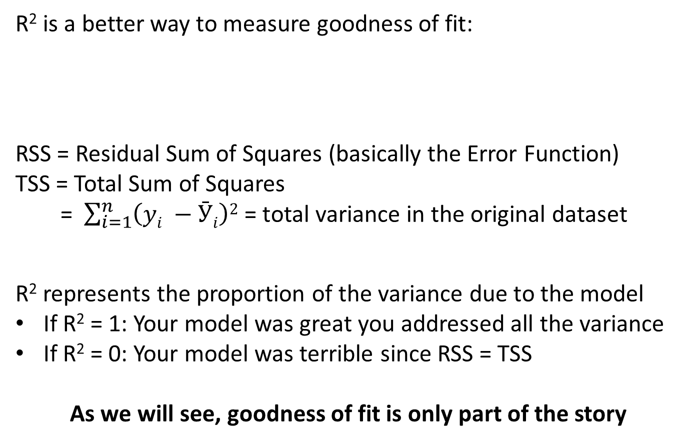
Statistical Measures of Goodness of Fit
R² is a better way to measure goodness of fit:
RSS = Residual Sum of Squares (basically the Error Function)
TSS = Total Sum of Squares
= $\sum_{i=1}^{n}{\left(yi −Ӯi\right)2}$ = total variance in the original dataset
R² represents the proportion of the variance due to the model
If R² = 1: Your model was great you addressed all the variance
If R² = 0: Your model was terrible since RSS = TSS
As we will see, goodness of fit is only part of the story

Slide 14
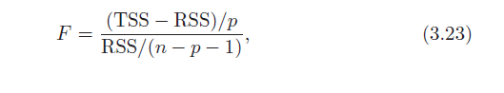
F Score
For the simple case of n samples and p features, we can test the correlation of all p features with the F-score (named after Fischer)
If RSS is small, F will get very large. This is a good model. Conversely, if RSS is almost equal to TSS, F will be close to 0.
F >> 1: Reject H₀, this group of features correlates to the outcome
F ≤ 1: Accept H₀, this group of features is not correlated to the outcome

Slide 15
Basic Model

Slide 16
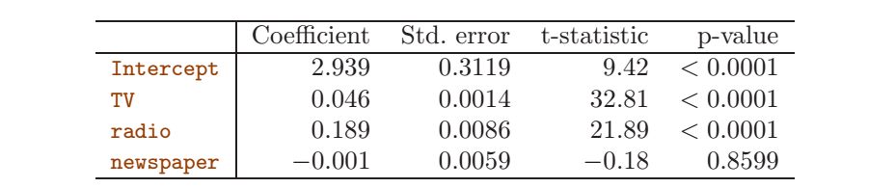
Single Regression vs Multivariate Regression
Table 3.3
Table 3.4

Slide 17
Interaction Terms
Figure 3.5
Table 3.9

Slide 18
Rigid vs Flexible Models
Models can be rigid or flexible.
Rigid models will not respond quickly to variations
Flexible models will respond very quickly to variations
Consider this generalized model for outcomes:
y_{i} = f(x_{i1}, x_{i2}, x_{i3}, …) + ε_{i}
According to the model above, each data point in our sample contains ε_{i}, some irreducible and un-modelable error. What happens if we model the irreducible error as well as f? Is that a problem?
Which type of model will overfit the noise, rigid or flexible?

Slide 19
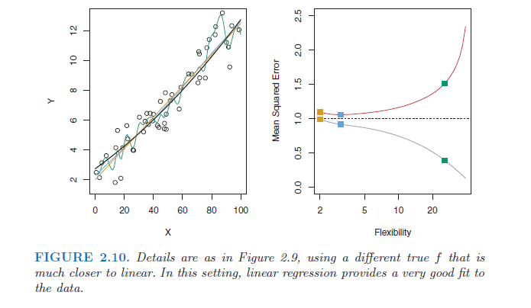
Bias Versus Variability, Linear Case
What do you think the actual noise level is for this data?
How did they find the minimum test error?

Slide 20
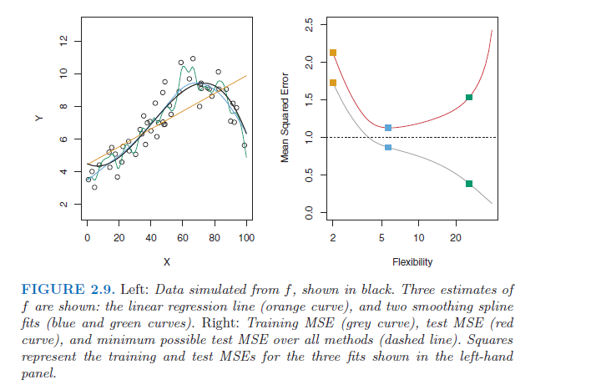
Bias Versus Variability, Non-Linear Case

Slide 21
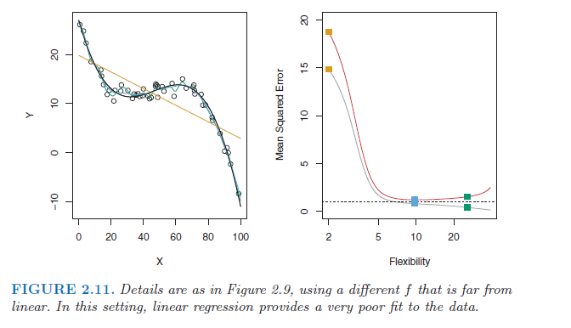
Bias Versus Variability, Another Non-Linear Case

Slide 22
Model Variability
Variability is the difference in the error if I apply the same model to many different independent datasets.
For example, I might have a set of data with a linear relationship between a feature and an outcome. But I model the data with a 5th order polynomial, modeling all the noise exactly.
If I apply this flexible model to an independent dataset, I’ll get a much different result.
This is also called overfitting the data and is very frequently done by analysts overselling their modeling capability.

Slide 23
Cross Validation
Thinking about the irreducible error:
We can never model it accurately
It may look like the real signal in the data we use to train the model, but it would not be consistent over the entire population
Q: Give that model, how would you test it against the population?
Would you:
Use the data you used to create the model and calculate the RSS?
Use an independent set of data from the same population to calculate the RSS?

Slide 24
Training Error vs Test Error
Training Error is the error you get when you run the samples you use to train the model back through the model
Decreases as you add more features (x_{j}’s, polynomial, and cross terms) to the model
If the coefficients vary significantly as you change training datasets, this can indicate “overfitting” – you are modeling noise
Test Error is the error you get when you run one or more datasets not used for training through the model
In the case of “overfitted” data, you will get large test errors compared to the training error

Slide 25
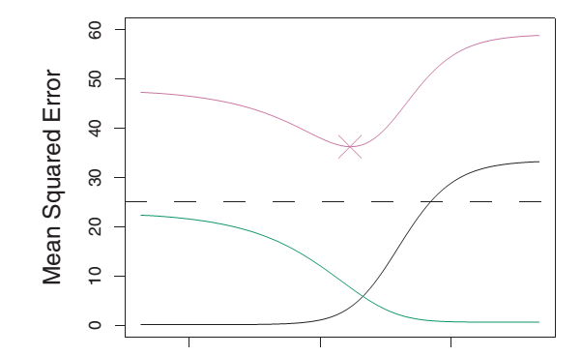
Training Error vs Test Error
Below is a graph that is typical of many models we will examine in this class. While training error can go down continually as we add complexity to a model, testing with independent data reveals that, at some point, the model is not getting better and overfitting takes over.
Test Error
Variability
Training Error or Bias
Increasing Flexibility →

Slide 26
Unsupervised Learning

Slide 27
ISLR Roadmap
Principle Components – Chapter 10.2
K Means Clustering – Chapter 10.3.1
Hierarchical Clustering – Chapter 10.3.2
This is out-of-sequence with the text BUT I want you to use these techniques when examining your candidate datasets for your projects

Slide 28
Unsupervised Learning
Supervised Learning: Optimizing a model using outcomes. The training data has known outcomes. You try to minimize the error between the known outcomes and the model predictions.
Unsupervised Learning: Creating or optimizing a model with no outcomes. The training data has NO outcomes, or you don’t know the outcomes.
Often, unsupervised learning means looking for structure or patterns in the data, so that you can develop a modeling approach for insight, predictions, classification, or estimation. Isn’t this how you should start your projects?

Slide 29
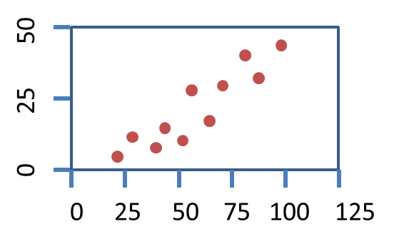
Principal Components Analysis
Where is the information in this data set?
In other words, which feature has the most potential for modeling the variability in the dataset?
X₂
X₁

Slide 30
Direction of maximum variance
X₁ and X₂ could explain about an equal amount of variance, but what if you could define a new variable that was a linear combination of X₁ and X₂?
X₂
X₁

Slide 31
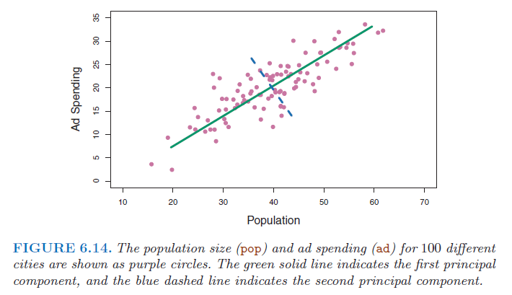
Principal Components Analysis
PCA will determine the direction of maximum variability and call it Principle Component 1. It will express this direction as a new feature, which will be a linear combination of the original features. Principle Component 2 will be orthogonal to PC1, in the direction of max remaining variability.
PC₂
PC₁
PC₁ = φ₁₁ * Population + φ₁₂*Ad Strategy
PC₂ = φ₂₁ * Population + φ₂₂*Ad Strategy

Slide 32
Principal Components
The new axes are combinations of the original axes
Linear combination means you multiply one or more of the original axes by a constant and add the result
Normal means the sum of squares for the constants is 1
Orthogonal means that the axes are independent ( mathematically it means they intersect at 90 degrees)
The software allows you to see how much variability each new variable represents. Although you may have started with 100 variables, you might find that 10 represent 99% of the variability.

Slide 33
Data Conditioning
Typically you want to shift and scale the variables before performing PCA
Note this is not necessary for linear regression. Why?
You are looking for max variance. When features are measured in different units, variance for one feature could overwhelm all others
Obviously the answer should not depend on your choice of units
Normalize the data so that the mean = 0, variance = 1
R will do this for you automatically if your flags are set correctly
If all features are measured the same way in the same units, you may not need to normalize
For example, if genes are measured as levels in a solution, you don’t need to normalize
Weights are unique up to a sign, so different software packages may give the opposite signs for the same weights

Slide 34
Maximum Variance = Minimum Error
Express new features Z_{j} that are normalized linear combinations of original features
To find the direction of maximum variance:
Note: This works because you already scaled and translated the data

Slide 35
PCA Graphically
In 2 Dimensions, this is just like rotating the original axis until the variance is maximized, or the error is minimized
1. Normalize the Data
0 25 50
-1 0 +1
0 25 50 75 100 125
-1 0 +1
-1 0 +1
-1 0 +1
-1 0 +1
-1 0 +1
3. This is Principle Component 1
2. Look for the maximum variance

Slide 36
PCA as the Min Error
Note PCA also gives you the minimum error from a line or plane
-1 0 +1
-1 0 +1
-1 0 +1
-1 0 +1
Error²
0 90
Angle of Rotation (from Horizontal), deg

Slide 37
Principal Components Analysis
Where is the information in this data set?
Note that the information content is highest where there is maximum variability. Typically this is where you may want to focus given a new set of unfamiliar data

Slide 38
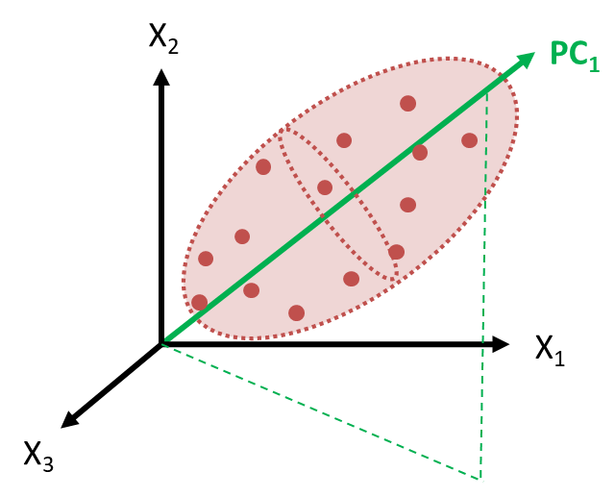
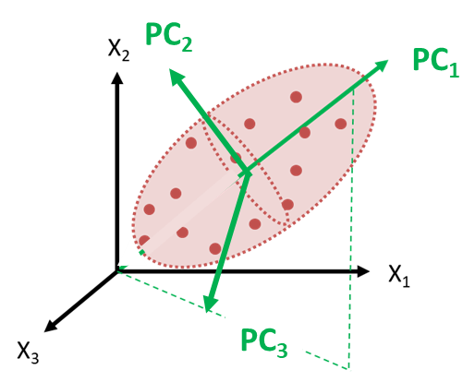
PCA Graphically
In 3 Dimensions, find PC1 and collapse the data along that dimension.
Then repeat.
PC₁
PC₂
PC₃ = PC₁ x PC₂

Slide 39
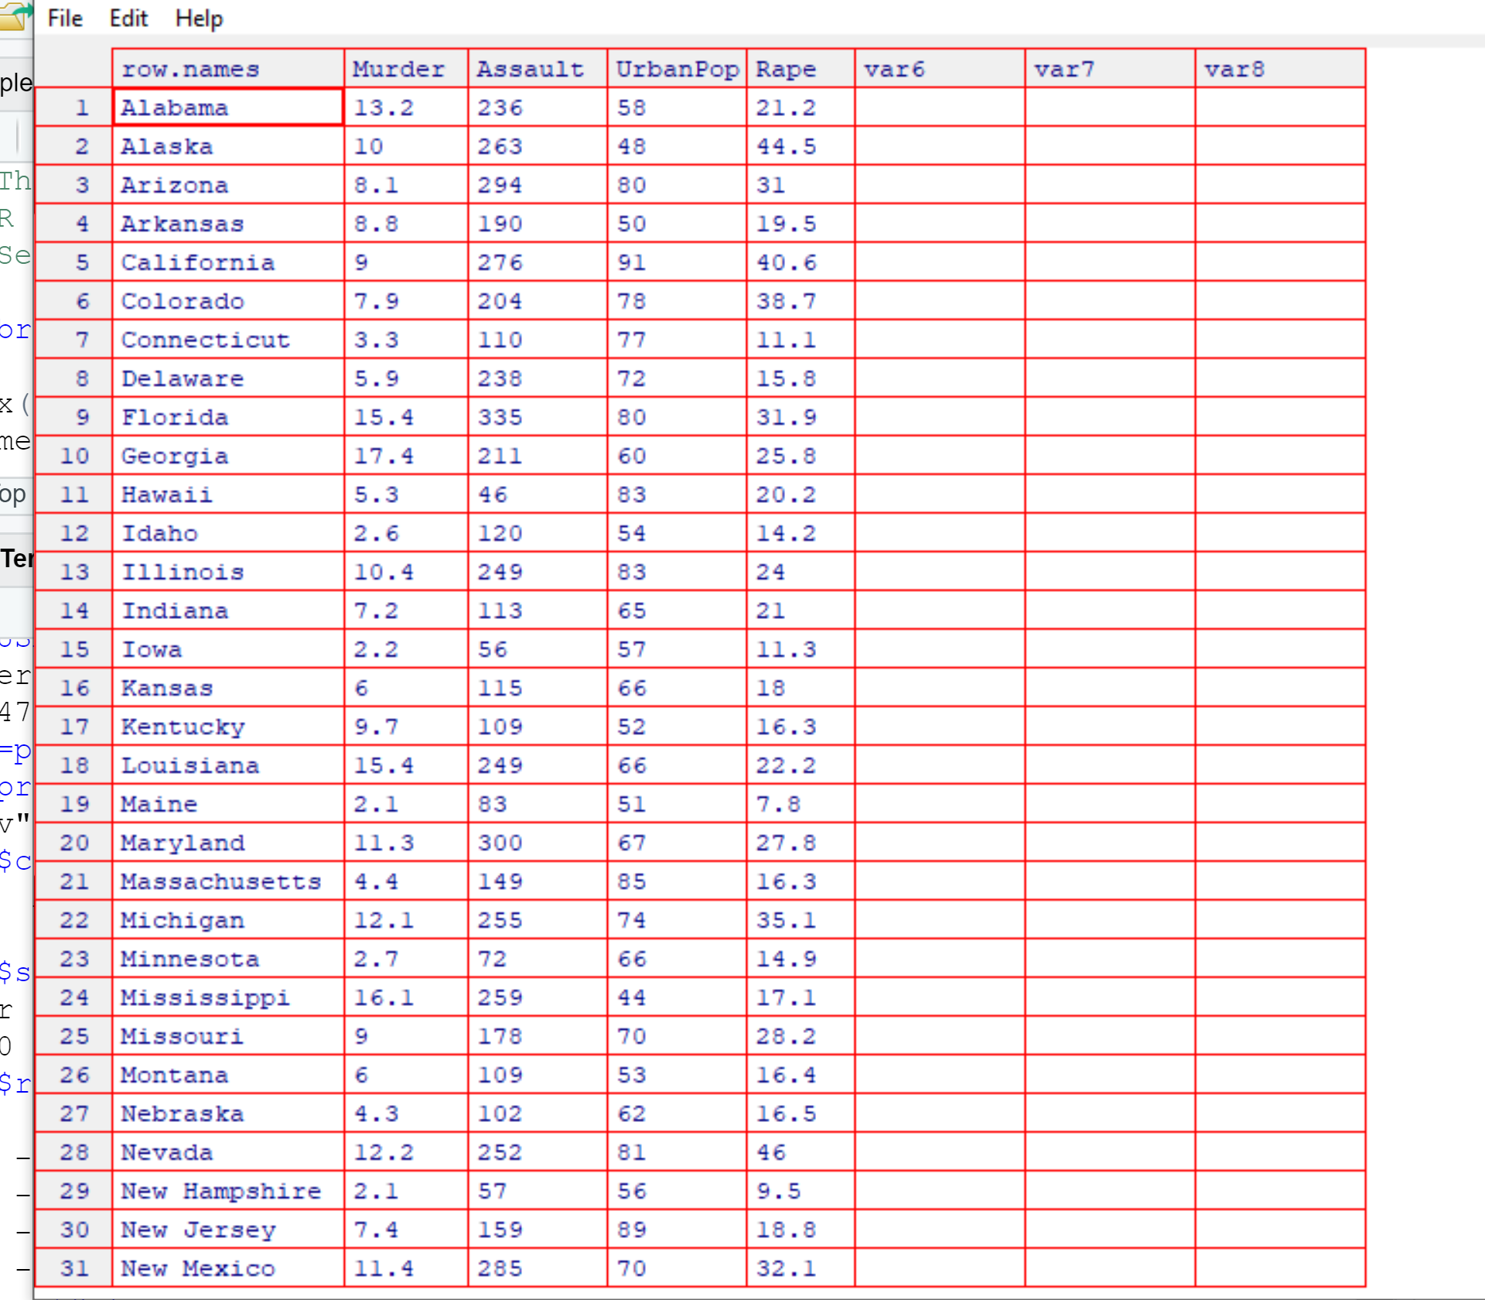
USArrests Table

Slide 40
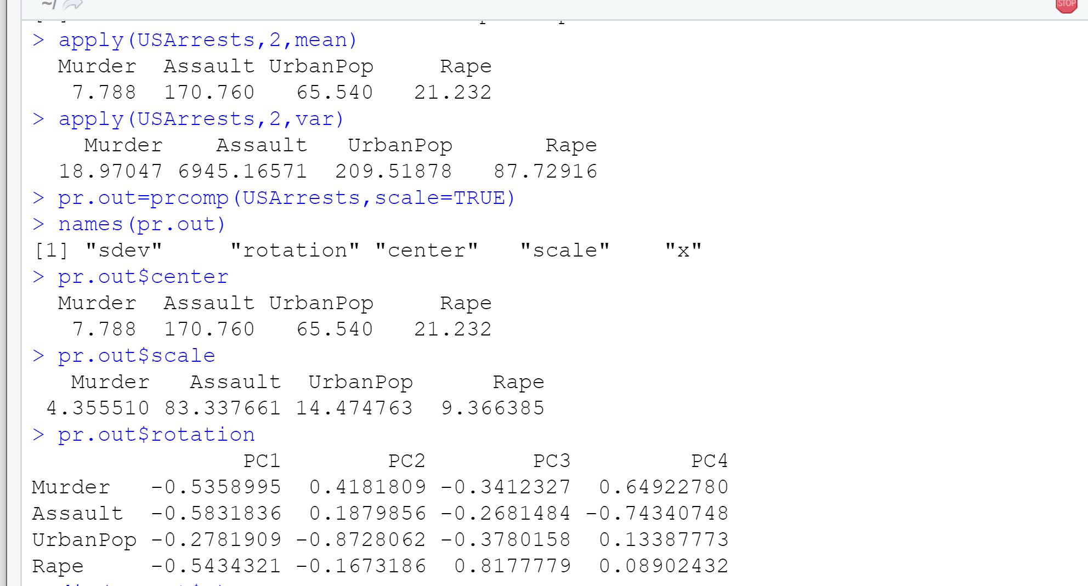
USAarrests
With 4 Features, you will get 4 Principle Components. However, the last few might not be very informative (i.e., not useful for your model).

Slide 41
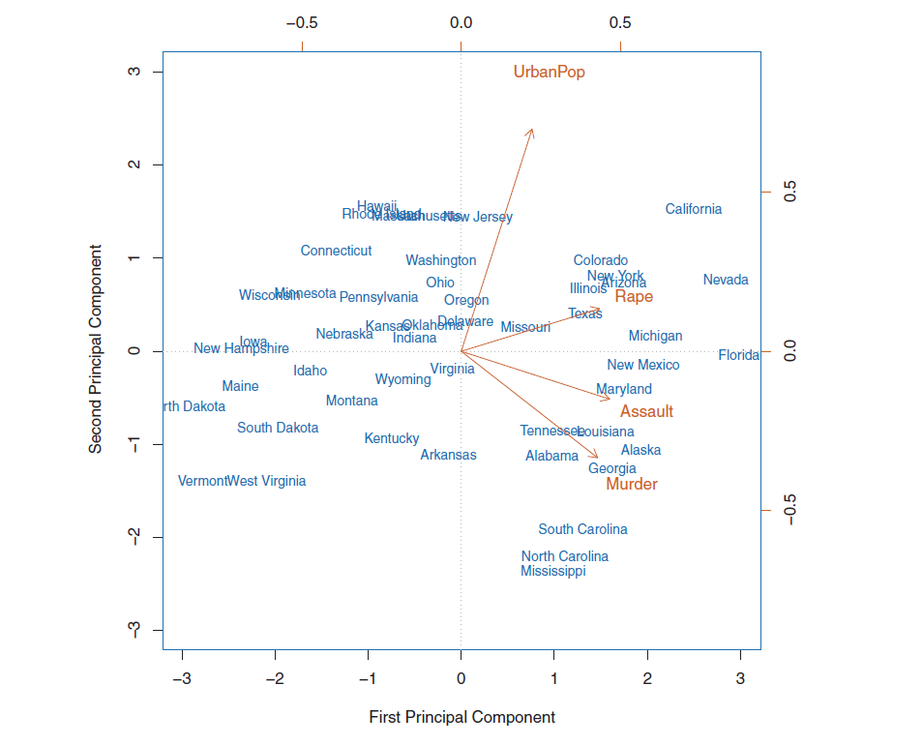
PCA Biplot = Loading and Scores

Slide 42
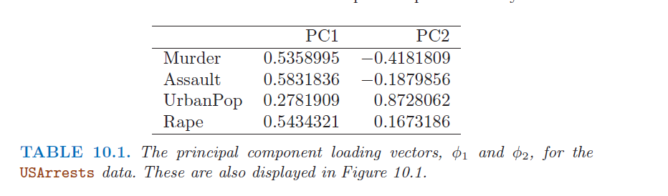
Principal Components
Principal Components Analysis can help you create a low dimensional representation of the data capturing as much information as possible.
The following is built from a dataset of arrests per 100,000 arrests in 50 states for 3 crimes, plus the state’s percentage of the population living in a city.

Slide 43
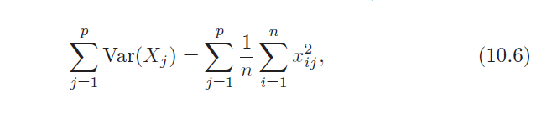
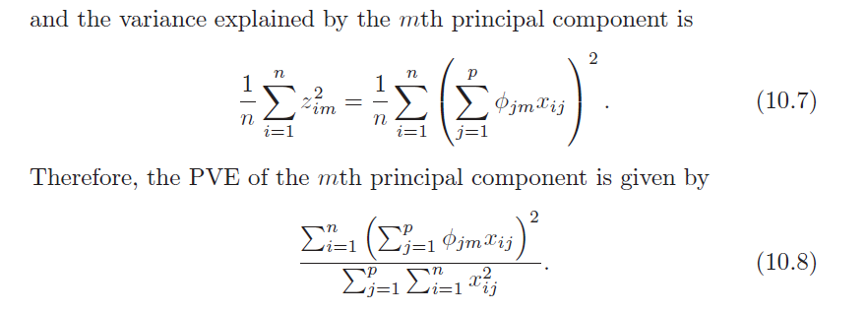
Percent of Variance Explained
Principal Component Analysis is a method of reducing dimensionality and simplifying the problem. But how do you know when to stop?
The total variance in a dataset is

Slide 44
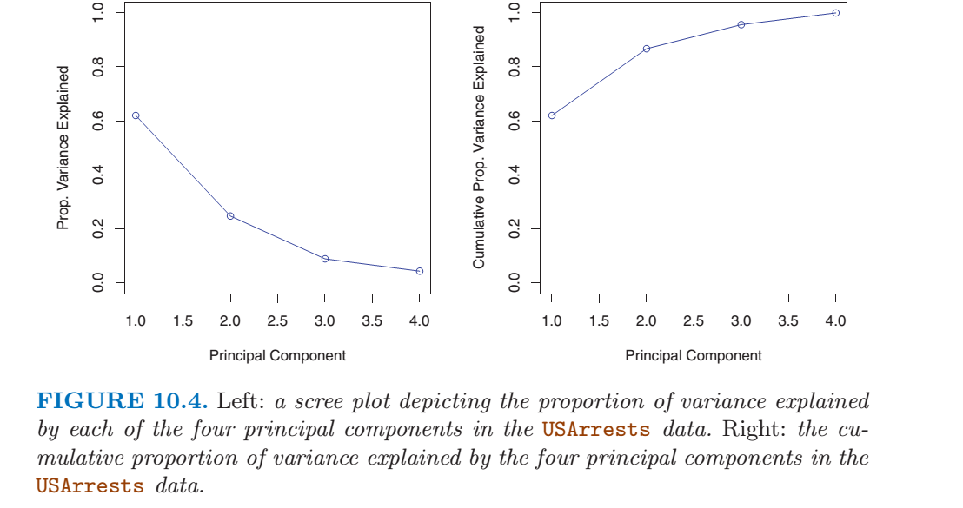
PVE

Slide 45
Principle Components Analysis
The bottom line: PCA can point you to the interesting part of your dataset, and can make sense of seemingly random data. It can help you sort through data with multiple dimensions, and find the important nugget of information.
PCA is a very powerful mathematical technique. Used in many advanced statistical formulations across many disciplines. Also known as an eigenvector formulation.

Slide 46
Unsupervised Learning: Clustering

Slide 47
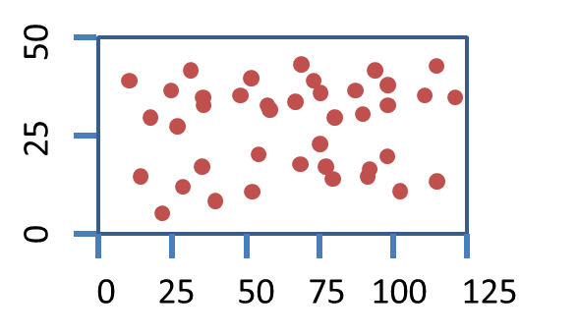
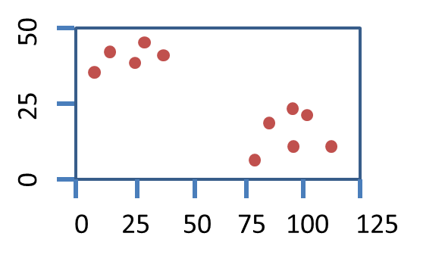
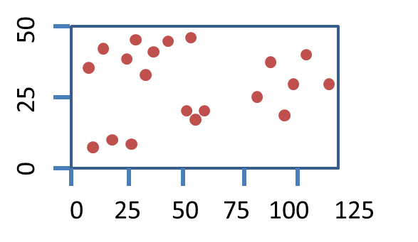
Clustering
We look for subgroups where all the observations are similar. That is, the variance within a subgroup is small (compared to what?)
Therefore, the observations between subgroups are NOT similar.
Similar and small are subjective. Consider these examples:

Slide 48
Nomenclature
We will assume we have K clusters. The value for K is left up to the analyst… you can plot the data then judge it by eye or make a random guess and see if it works out.

Slide 49
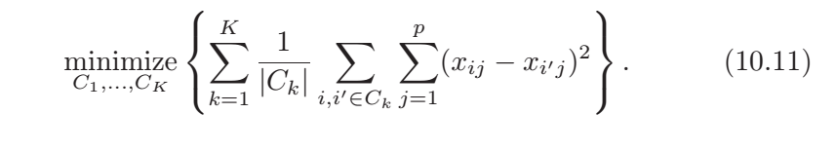
K-Means Clustering Using Geometric Distance
K-Means clustering is a simple minimization problem. You try to minimize the amount of variation within a cluster. It is very dependent on your initial selection of K.
The problem can be solved iteratively.
(x_{ij} – xi_{’j’})² is the Euclidean Distance in this spatial example

Slide 50
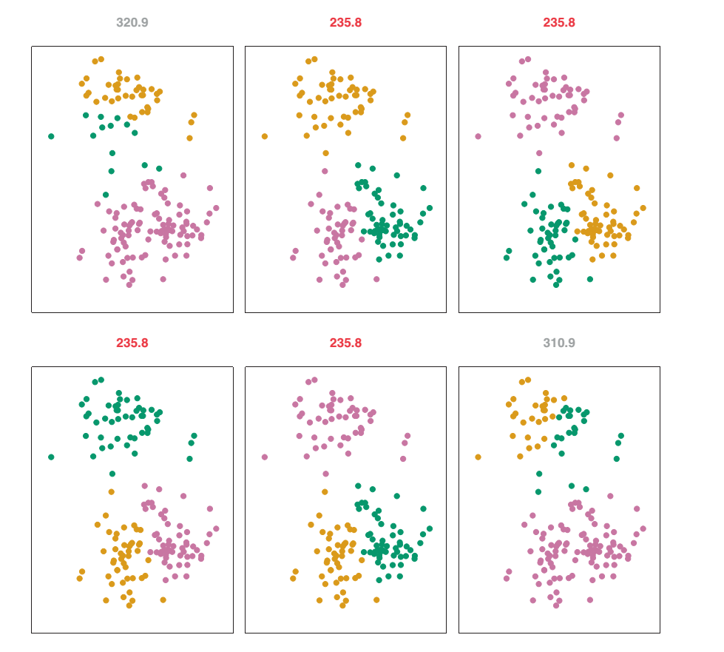
K Means Clustering
Different initial assignments of the data yields 3 different local minima. The in-cluster variance (Eq. 10.11) is shown above each result.

Slide 51
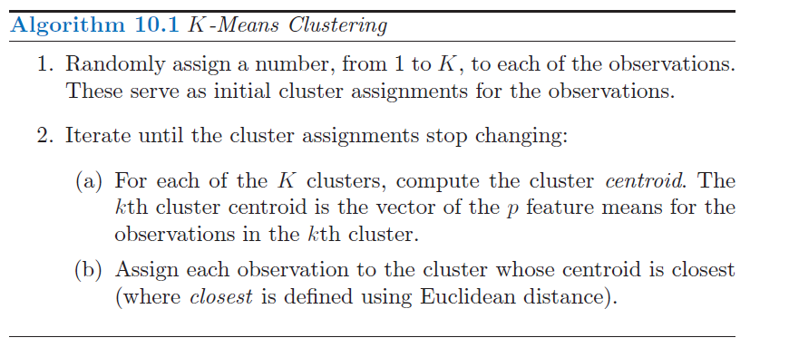
K-Means Clustering
You stop when the centroids do not change any more. Since the algorithm can find local minimums, you must rerun the algorithm several times with different starting conditions.

Slide 52
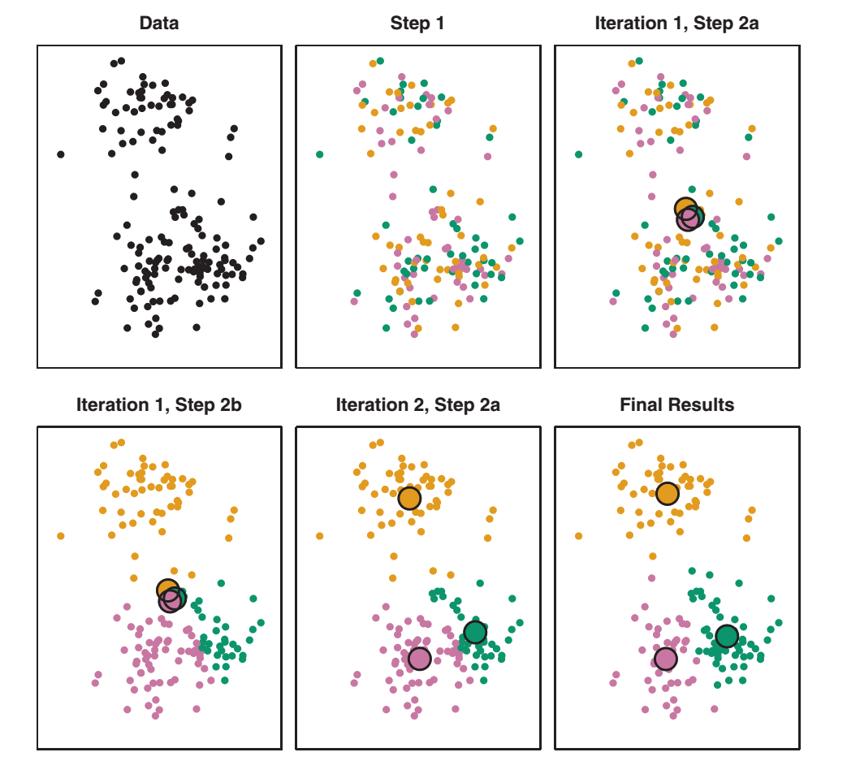
K-Means Clustering

Slide 53
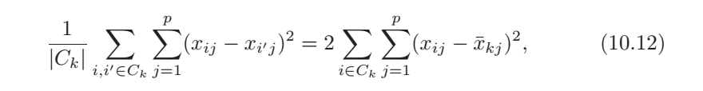
K Means Clustering
The Euclidean Distance settles to a constant at the local minimum.
Since this is only a local minimum, you must redo the problem with different initial conditions.

Slide 54
Hierarchical Clustering
In K-means, you must guess at the number of groups, K.
For hierarchical clustering, you have a method to find out how many clusters are inherent in your data.
The method here is a bottom up method, called agglomerative clustering.

Slide 55
Hierarchical Clustering
With no outcomes, how do you come up with the right number of clusters?
You can start with the individual observations (called leaves) and calculate the “distance” between each pair. Group the closest ones and repeat the process until you get to one trunk.
Then you can decide what the real separations are and what separations are arbitrary.

Slide 56
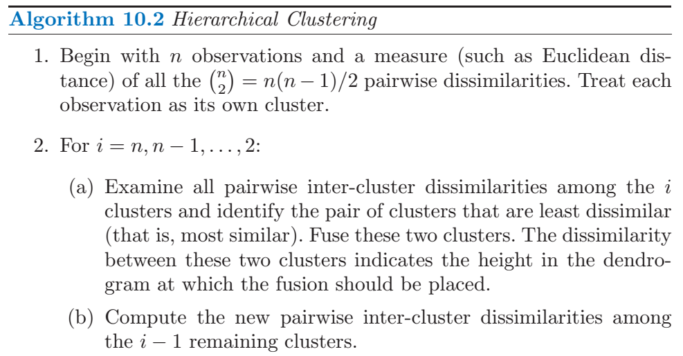
Hierarchical Clustering

Slide 57
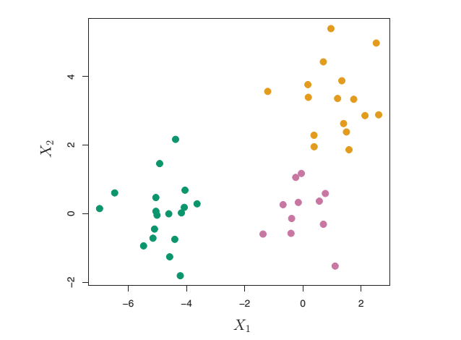
Hierarchical Clustering

Slide 58
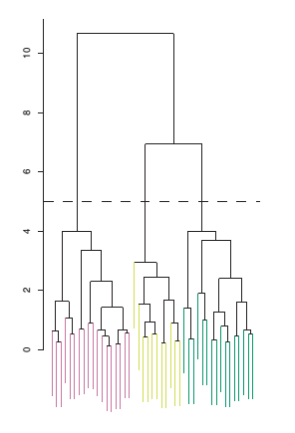
Dendrogram

Slide 59
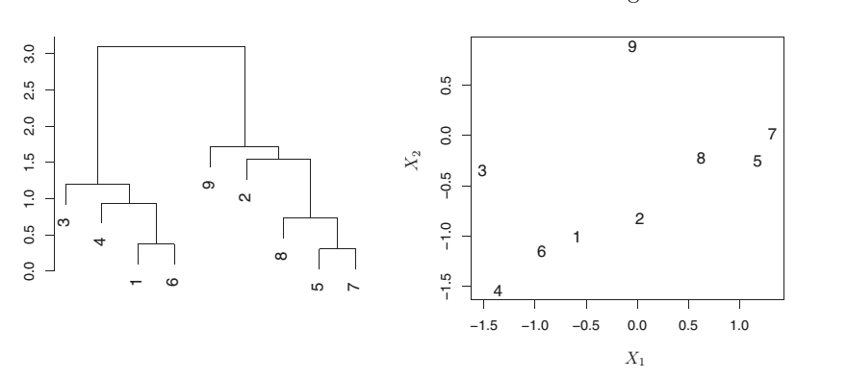
Another Hierarchical Clustering Example
This example shows that on a dendrogram, similarity must be judged based on vertical distance, not horizontal distance

Slide 60
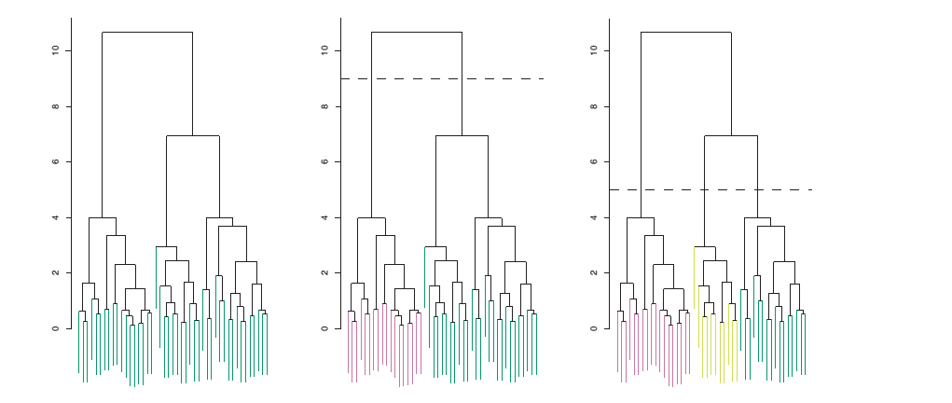
Hierarchical Clustering
You can select the number of classes you want based on your cut line

Slide 61
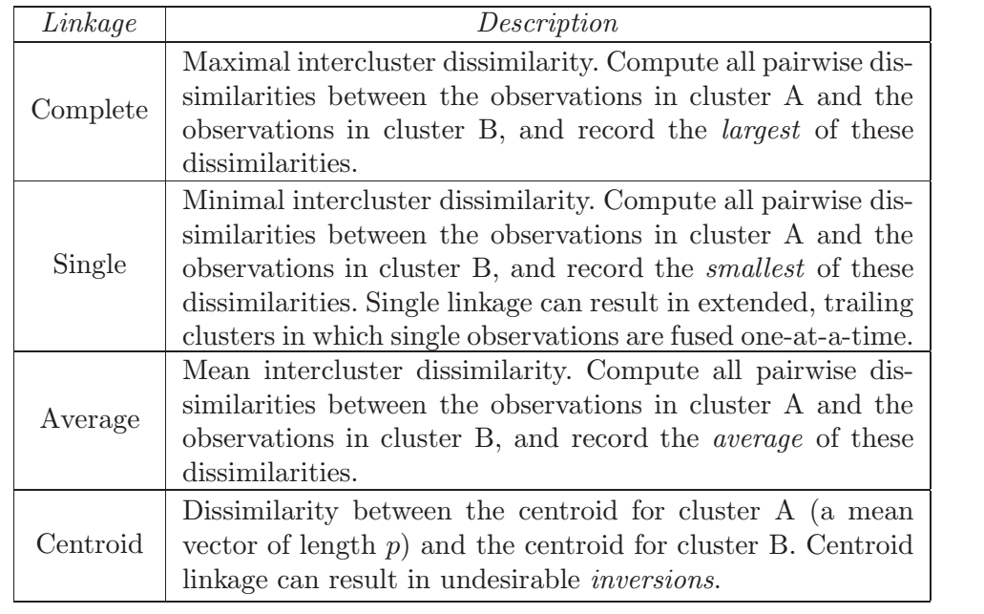
Methods of Scoring Clusters

Slide 62
Euclidean Distance vs Correlation
What is best to use if I’m looking for similarities in shoppers?

Slide 63
Sales Driven by Price

Slide 64
Homework #10 (page 1 of 2)
Read Chapter 10 and work through all the labs. (Don’t hand in the labs.)
Do Chapter 10 Problem 2
Do Chapter 10 Problem 3
Do Chapter 10 Problem 8
Do Chapter 10 Problem 9
Due January 29

Slide 65
Homework #10 (Page 2 of 2)
Look for datasets that are relevant to your chosen field for your Machine Learning project. Download a few of the best ones:
Free
Not restricted for use (you can share with the class)
Diverse (lots of data and several promising features)
Apply PCA to one or more datasets that you are looking at for your project. Apply K means clustering with a different number of clusters, and perform hierarchical clustering on the same datasets using 2 or 3 different methods of scoring (see previous chart). What did you learn about your dataset? Don’t hand these in now, hand them in with your analysis report later in the semester.

Slide 66
BREAK

Slide 67
Project Discussion

Slide 68
Machine Learning Project Goal
The goal of the project is to apply the concepts you are learning to real-world problems.
Some of the necessary skills include:
Listening to the Customer needs (for future reference)
Articulating project goals
Understanding the data
Selecting the appropriate analytic technique(s)
Performing quality control and error estimation
Communicating your results

Slide 69
Machine Learning Project Ground Rules
Each student will do their own project. Collaboration with other students and the TA’s is encouraged but the analysis and explanations in the final report must be done by the student.
The topic and dataset will be selected by the student and approved by me. There will be 2 deliverables: an Analysis Plan and a Final report. Each student will lead a discussion with the class on their final results and conclusions.
There will be no room for procrastination! Most weeks there will be a homework problem relating to your project. You will hand it in well before the end of the semester so we can discuss it and so it won’t interfere with your exams.

Slide 70
Project Deliverables
Project Plan
Topic
Problem Description
Unsupervised Learning Results
Data Selection
Analysis Plan
Preliminary Supervised Learning that you have completed
Preliminary Conclusions
Final Report
Data Curation
Supervised Learning Results
Conclusions
Follow On Recommendations
Presentation

Slide 71
Project Schedule
Activity | Deliverable | Date
Class Discussion of Project |  | February 5
 | Project Plan | February 12
Class Discussions |  | February 14
 | Project Plan Revision | February 21
 | Final Report | Apr 8
Presentations |  | Aprils 15, April 22

Slide 72
Data sets for Consideration
Think about an area you want to pursue in the long term. Use this project as an introduction to this longer term project.
Potential Sources for datasets:
http://www.kdnuggets.com/datasets/government-local-public.html
https://github.com/caesar0301/awesome-public-datasets#economics
http://libguides.geneseo.edu/c.php?g=67454&p=434785#s-lg-box-1300425
Good for sports analytics, could probably get a dataset from here:
http://www.databasesports.com/

Slide 73
Analysis Plan Specifications Topic, Problem Description, Unsupervised Learning Results, Data Selection, Analysis Plan, Supervised Learning Results, Preliminary Conclusions
Section | Description | Pages
Introduction | Why you are interested in the subject area that you selected for your project | 1 paragraph
Problem Description | What problem are you trying to solve? Who is the Customer? What will be the effect on the Customer? | ½ page
Unsupervised Learning Results | Look at some candidate datasets. Plot data, perform PCA, clustering, and other techniques. Do you have sufficient data? What is the quality? | A few pages
Analysis Plan | What results will you need to solve the problem or answer the question? How do you plan to get them? What data conditioning will you need to do? | ½ page
Preliminary Results and Conclusions | Include any Supervised Learning Analysis you have done. What conclusions can you make form this work? | 1 to a few pages

Slide 74
Data Curation
Curation is the conditioning of the data so you can do your analysis. What are you going to do with missing data? Is data repeated? Is there ambiguous data? Are the units provided and consistent? Do we need to scale and center the data?
Understanding the data requires you to find answers to questions like: Is the data field discrete or continuous? What is the range (for continuous) or the allowable values (for discrete)? Which features are related to others and which are independent?
Results Visualization
Data Analysis
Data Curation
A Typical
Data Analytics
Project

Slide 75
These will cause Your Linear Model to be “Bad”
Nonlinearity – The relationship between feature and outcome is curved. Look at residuals to see if relationship is nonlinear.
Collinearity – 2 or more features are closely correlated.
Correlated Errors – Ideally errors are random and by definition not able to be modelled. If errors are correlated with each other then the model will look better than it is. P will be artificially low, 95% conf. levels too small.
Non-Constant Variance (Heteroscedasticity, also know as Multiplicative Noise) – Errors scale with feature level. Graph of data has a funnel shape
Outliers – One or more unusually large residual(s). May affect model and estimates of model goodness.
Leverage Points – Feature samples in a dataset that are far from the rest. If dropped you get a much different model.

Slide 76
Mitigation Techniques
Error | Effect | Mitigation
Nonlinear | Good model within a certain range but regions where model is very bad | Use nonlinear technique
Collinear | Include too many features in the model making it hard to use and unstable | Drop one variable of the pair that are colinear
Correlated Errors | P values artificially low, leading to inclusion of features that are not significant. Again hard to use. | Eliminate outcomes that make the errors correlated
Heteroscedasticity | Errors vary based on the distribution of features | Scale data and use nonlinear techniques
Large Outliers | A few points can dominate the optimization | Drop outliers, but be careful. Compare predictions.
Leverage Points | A few points can dominate the optimization | Drop high leverage points, but again be careful.

Slide 77
Final Results, Conclusions, Follow On Recommendations
The Final Results are the statistical learning results that answer the original objectives of the project. Present the models you developed, the modeling parameters you used, and the predictions or estimates.
Be sure to include how you determined how accurate and how robust you think the model(s) is(are).
If the original plan did not work out and adjustments had to be made, please describe this process and why you made the choices you did.
Visualization of the results is encouraged, but we’re not doing a data graphics course. Focus on the techniques we covered in class and which apply best to your project.
If you already know Statistical Learning and want to go deep into 1 technique, please see me and we’ll work something out.

Slide 78
Final Report: Specifications
Section | Description | Pages
Objective | Succinctly state the topic and objective(s) | 1 or 2 paragraphs
Analysis | Summarize the analysis techniques you selected and why. Essentially resubmit the analysis plan with changes, if any, but focus on the techniques that were most meaningful. | 1 or 2 pages
Results | Summarize the results. Are they what you expected? Did you achieve all, part, or none of your success criteria? | 1 page plus 2 or 3 graphs as necessary.
Conclusions | Succinctly state the 2 or 3 major conclusions | 2 or 3 paragraphs
Follow on Work | What could be done next to further examine the data? | ½ page
Lessons Learned | Discussion of what were the major problems, what could have been improved | ½ page
Appendix | All your Unsupervised and Supervised Analysis | Unlimited

